Slide 1
Pure-Connect
A Social Media App

Slide 2
Objectives
Enhance Online Social Interactions: Create a platform that facilitates meaningful connections and interactions among users.
User Engagement and Retention: Provide features that encourage users to spend more time on the platform, leading to increased retention rates.
Promote Positive User Experience: Prioritize user-friendly design, intuitive navigation, and seamless functionality to ensure a pleasant experience.
Implement Cutting-Edge Security Measures: Utilize advanced security protocols to protect user data and privacy.

Slide 3
INTRODUCTION
Background:
In today's digital age, social media has become an integral part of our lives. It's a platform for people to connect, share experiences, and discover new content. However, existing platforms often face challenges like information overload, privacy concerns, and toxic behavior.
Our Solution:
Our social media app is a revolutionary social media platform designed to address these issues while providing a seamless and enjoyable user experience. Our application focuses on fostering genuine connections, promoting positive interactions, and ensuring user safety.

Slide 4
Key Features
Login
Sign Up
Password Reset
User Profiles
Edit Profile
Post With Photos and Videos
Follow System
News Feed
Comments, Likes and Content Sharing
Active Notification
Dark Mode
Search Followers/Followings

Slide 5
Open App
WORKING FLOW
Decision
Registration
Login
Enter Into
Home Page
Profile
All Posts
Search Friend
Notification
Followers, Followings
Edit Profile
React on Post
Comment on Post
Follow Request
Post
Close App

Slide 6
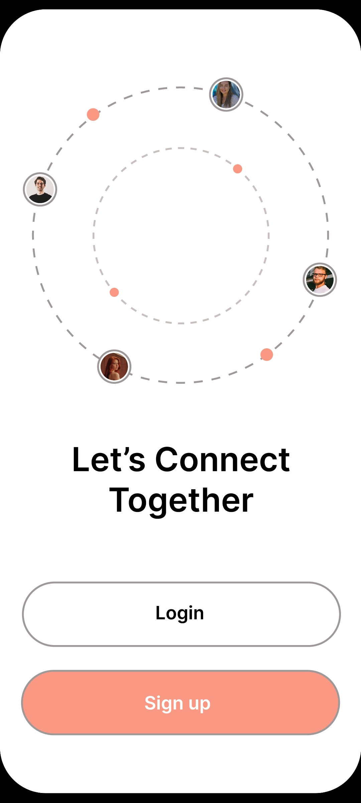
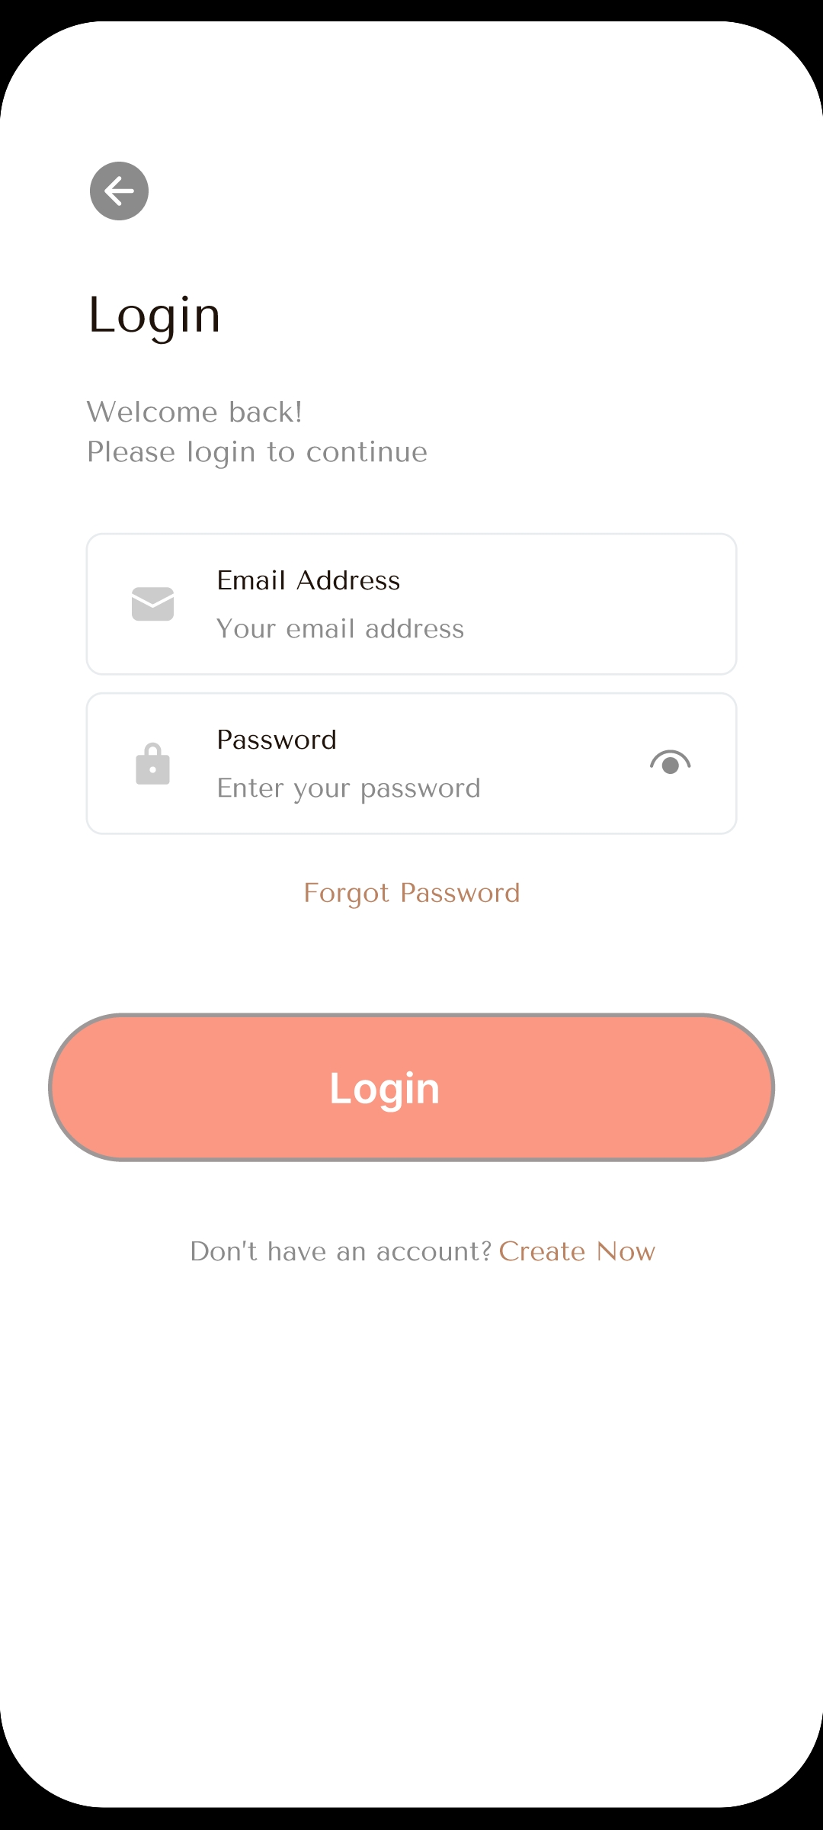
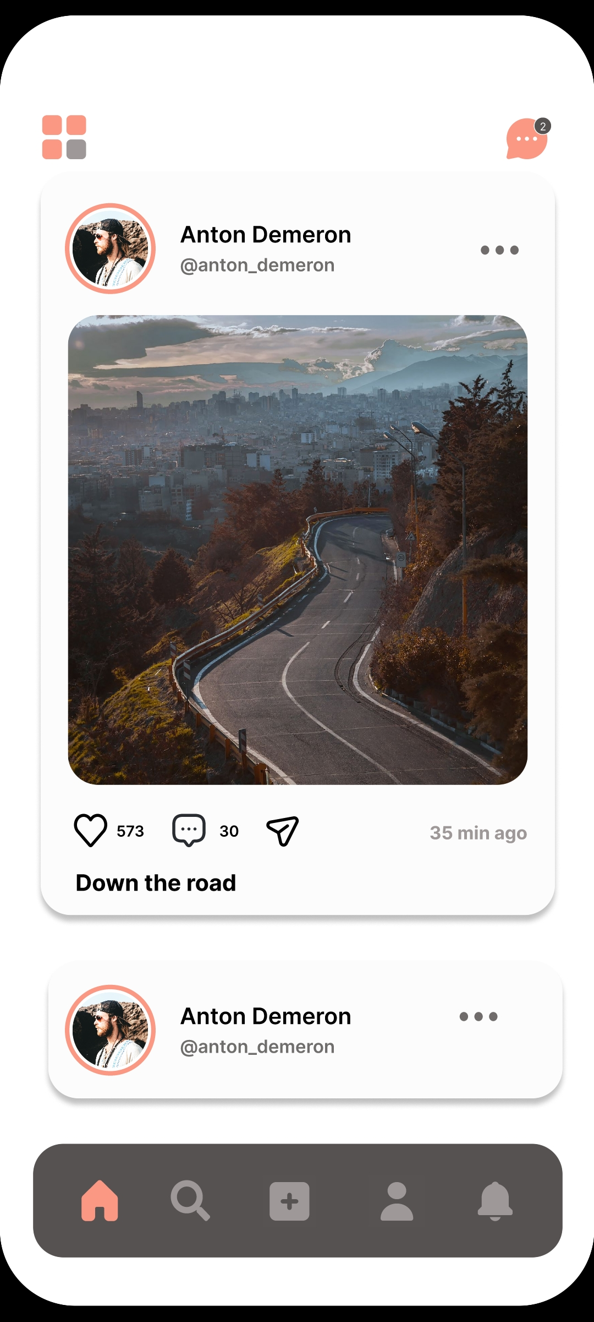
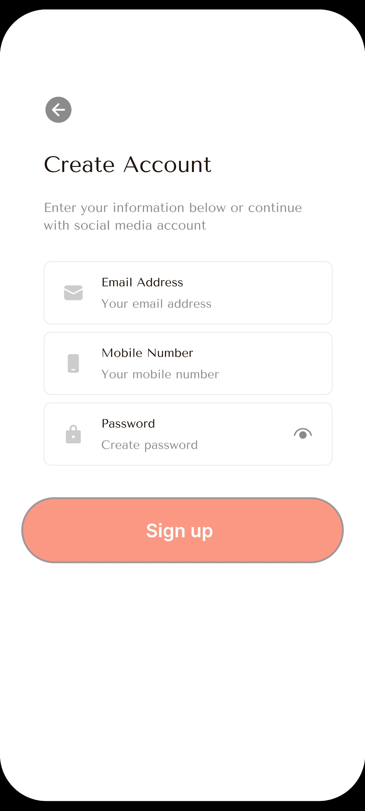


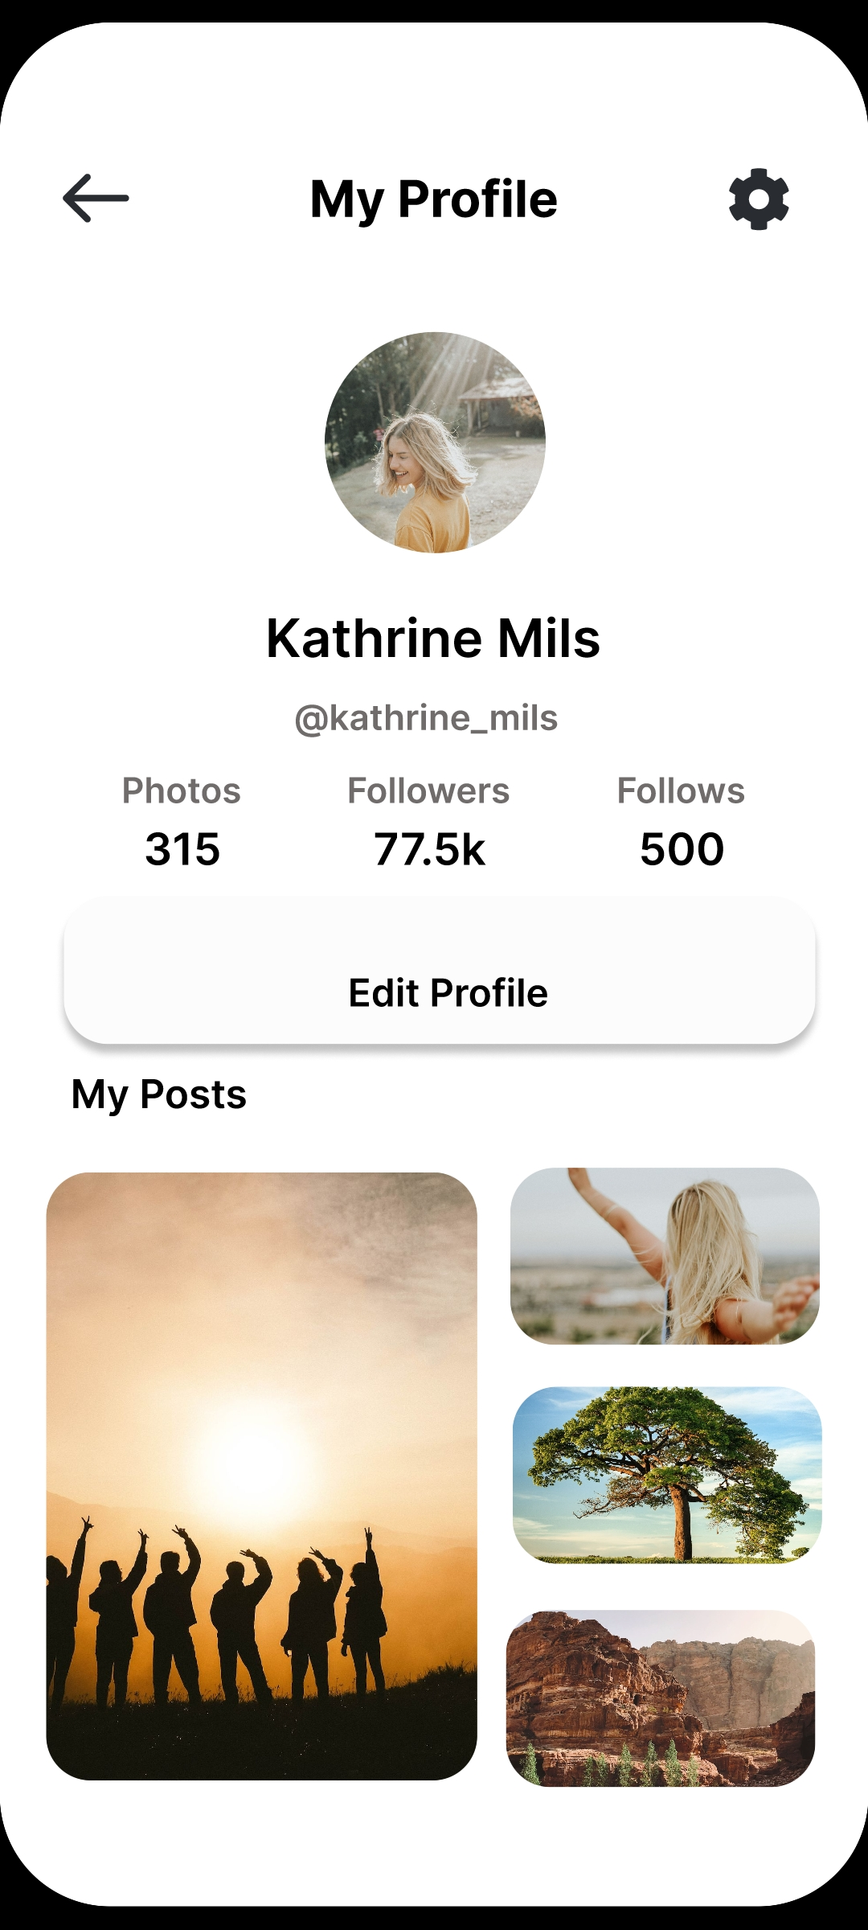
Start Screen

Slide 7
Login Page

Slide 8
Signup Page

Slide 9
Timeline

Slide 10
User’s Profile

Slide 11
User’s Album

Slide 12
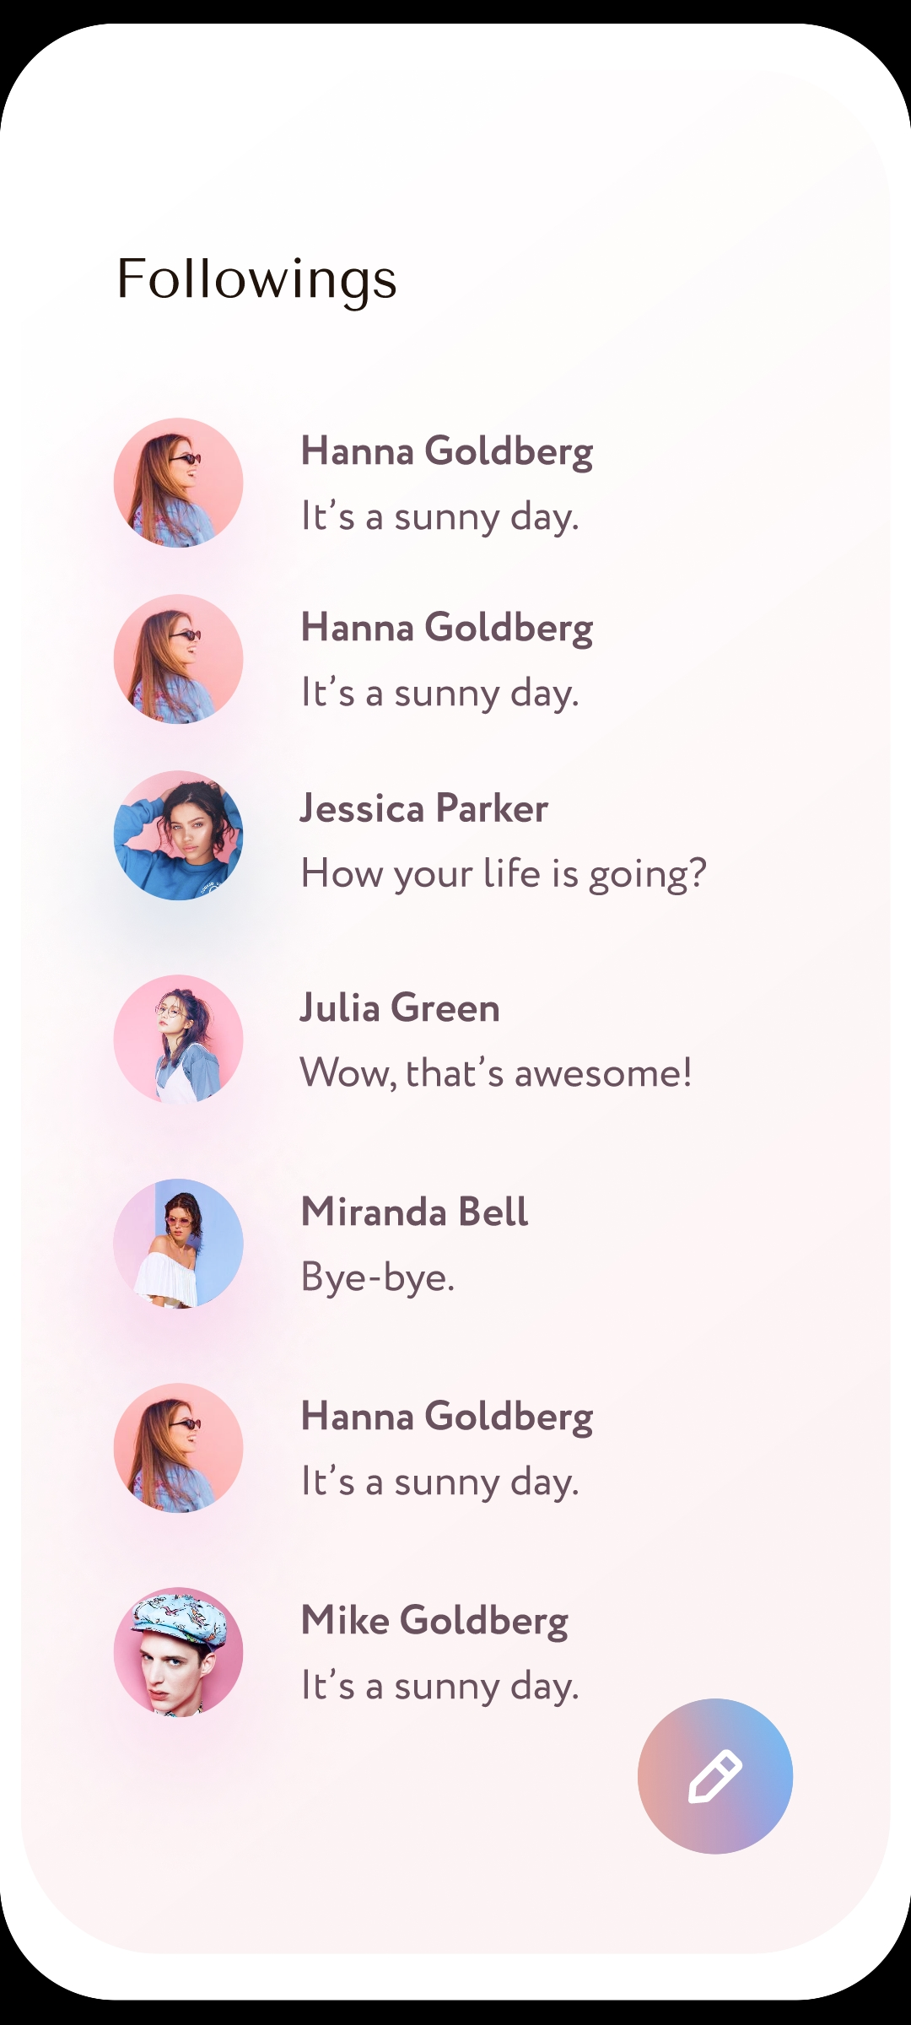

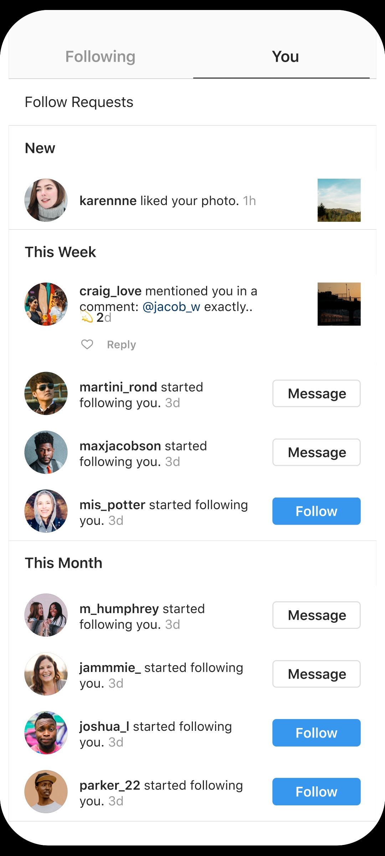

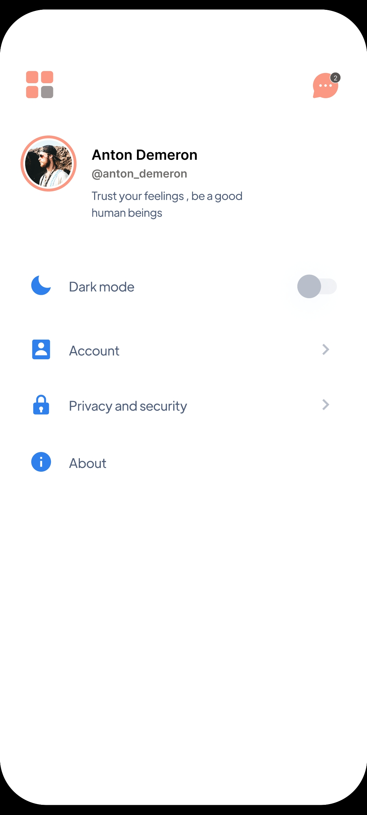
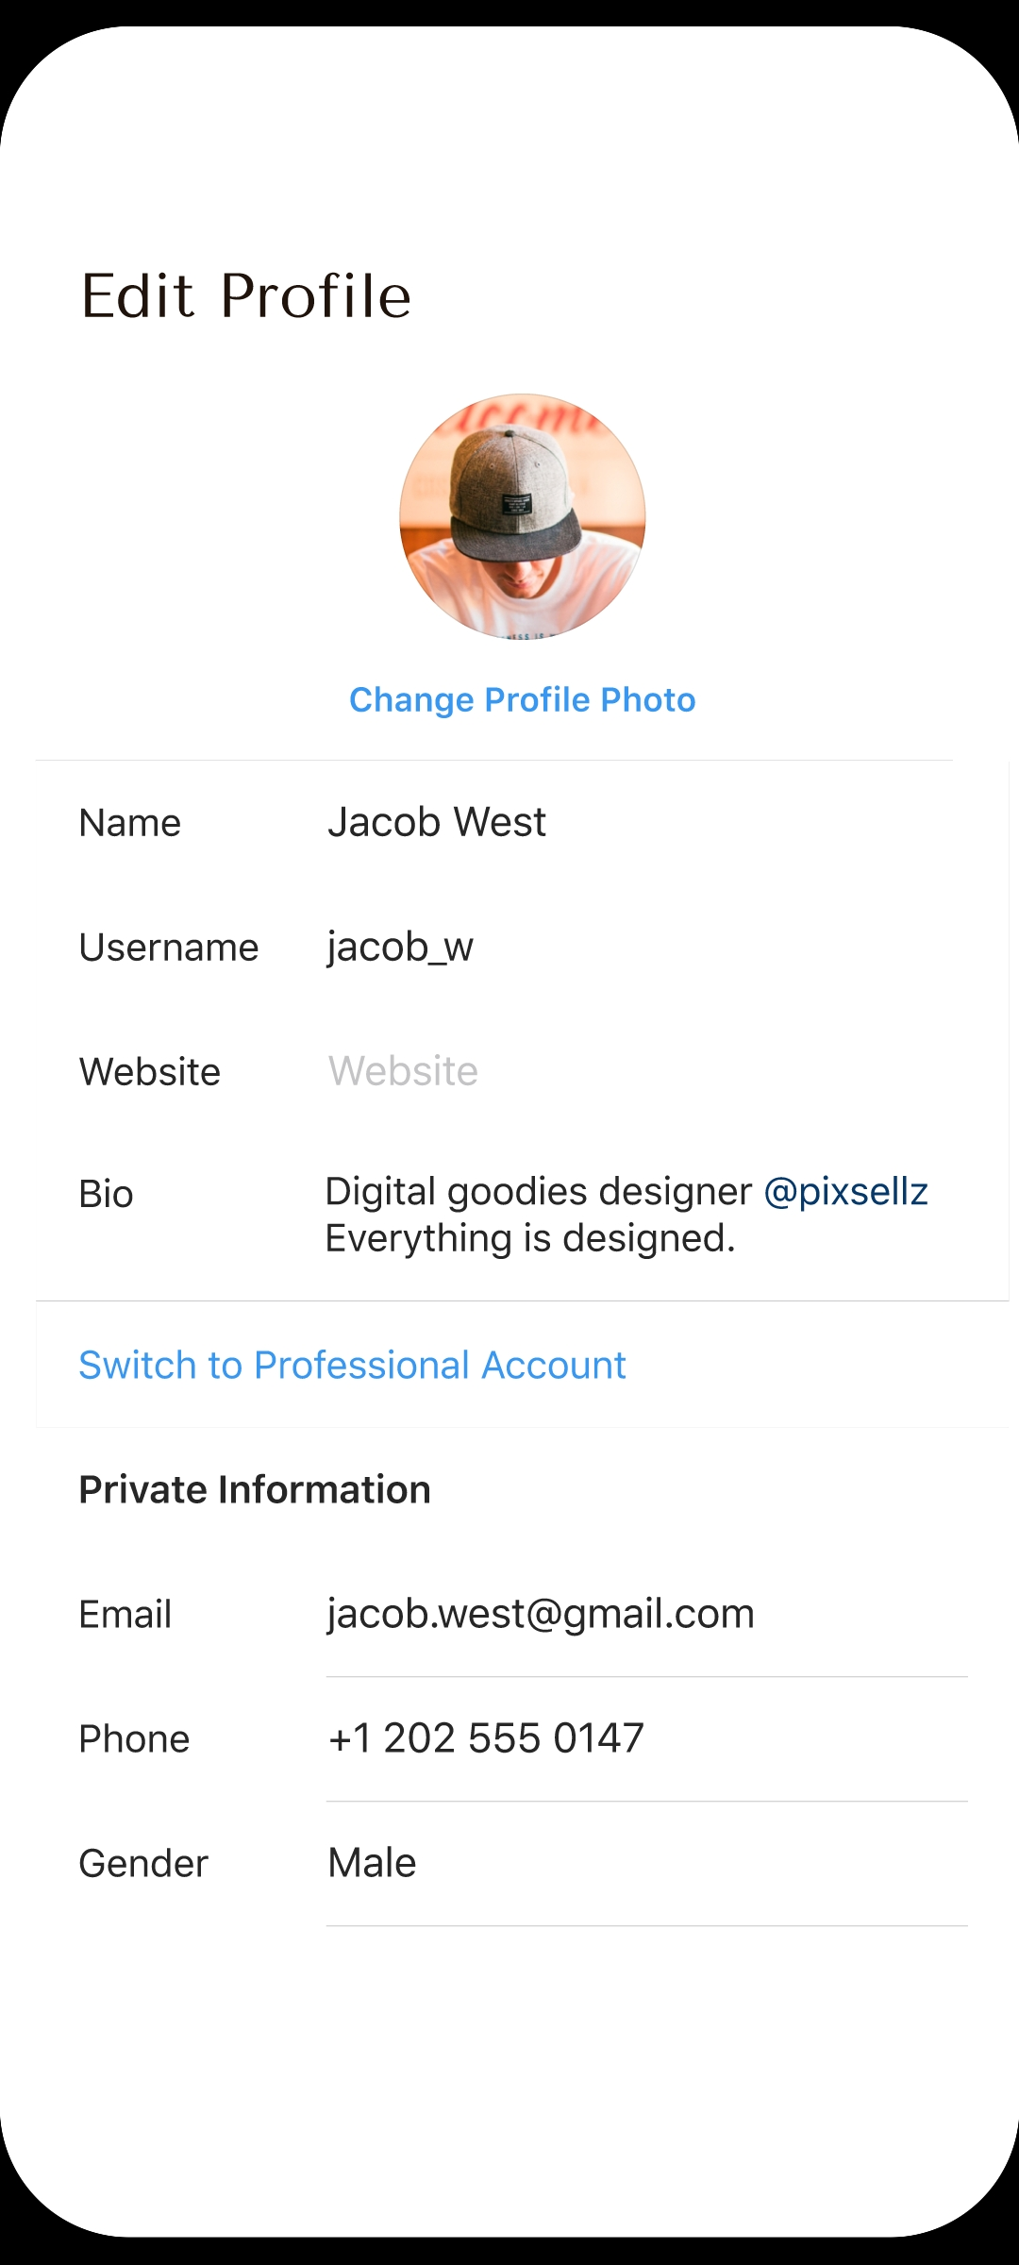
Profile Settings

Slide 13
Edit Profile

Slide 14
Reset Password

Slide 15
Create a Post

Slide 16
Notifications

Slide 17
Other’s Profile

Slide 18
Technology USED
Swift: Swift is Apple's preferred programming language for iOS app development. It is powerful, easy to read, and has a syntax that is concise yet expressive. It's designed to be fast and safe.
Xcode: Xcode is the official integrated development environment (IDE) for iOS development. It provides a comprehensive set of tools for writing, testing, and debugging iOS applications
Firebase: While not a native iOS technology, Firebase is a popular platform provided by Google that offers a suite of services for app development, including authentication, real-time databases, cloud storage, and more.
Json Parsing: for Comments and Replies and displaying Notifications.

Slide 19
Why You Should buy our app
Unique Value Proposition:
Our application offers a fresh approach to social networking, addressing common pain points in the industry.
Social media is replacing mass media.
Nowadays, People don’t prefer television, newspaper for daily affairs.
Proven Track Record
Our team has a history of successful app development and a strong understanding of user needs.

Slide 20
THANK YOU

